Slide 1
The debate over immigration in the US
Presented by Jean-Maxime Djanett and Henry Letellier

Slide 2
Summary
The anti-Mexican poster
The meaning of the poster
An extract of the song “ land of the free”
The context of the song “land of the free”
The context of the song “land of the free” and the see saw
Our personal opinion
Credits

Slide 3
Summary
The anti-Mexican poster
The meaning of the poster
An extract of the song “ land of the free”
The context of the song “land of the free”
The context of the song “land of the free” and the see saw
Our personal opinion
Credits

Slide 4
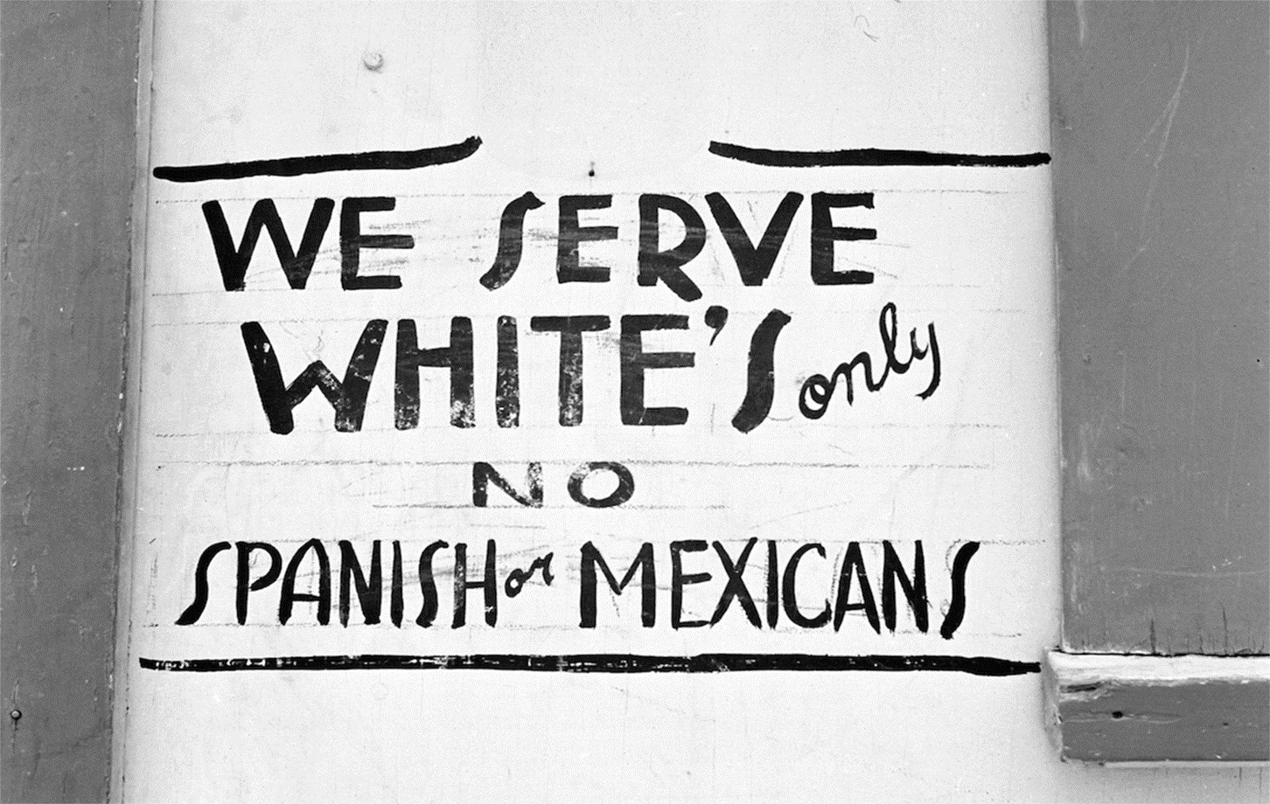
The anti-Mexican poster

Slide 5
Summary
The anti-Mexican poster
The meaning of the poster
An extract of the song “ land of the free”
The context of the song “land of the free”
The context of the song “land of the free” and the see saw
Our personal opinion
Credits

Slide 6
The meaning of the poster
Countless sings and posters
Font links to racist anti-immigration movement
34 Millions of Americans in the U.S are originally Mexican in 2013
U.S 2nd place with the most Mexicans
2008 about 7 000 000 were illegal in the U.S
Civilian groups created to apprehend illegal Mexicans
Donald Trump says illegal mexcicans are criminals, rapists, and drug smugglers or dealers
2003-2007: California has the largest Mexican deaths due to crime.
Many more incidents not menchionned in this presentation.

Slide 7
Summary
The anti-Mexican poster
The meaning of the poster
An extract of the song “ land of the free”
The context of the song “land of the free”
The context of the song “land of the free” and the see saw
Our personal opinion
Credits

Slide 8
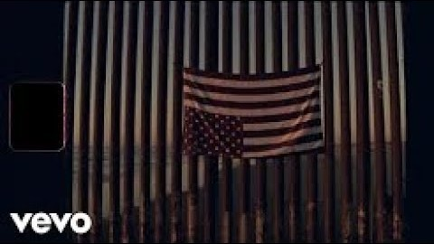
An extract of the song “land of the free”

Slide 9
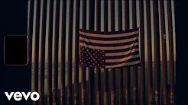
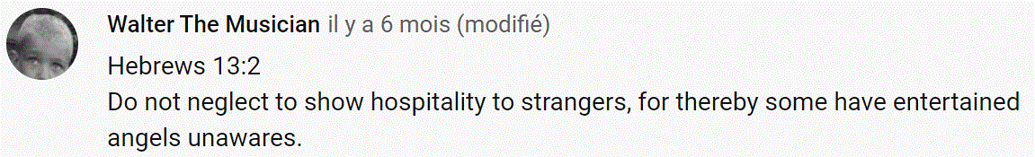

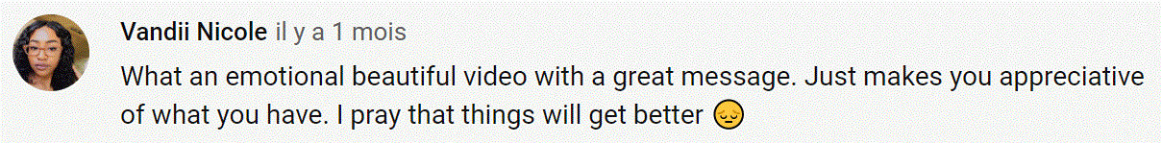
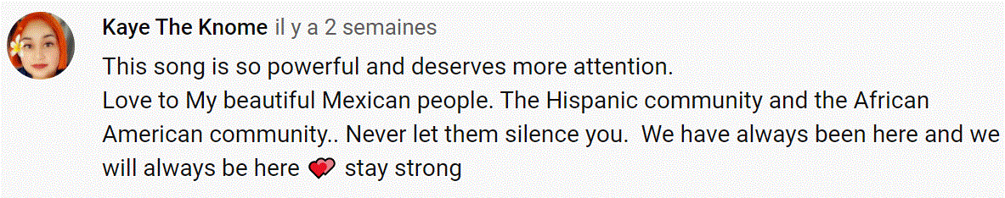
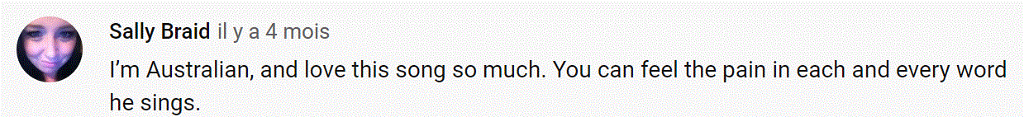
An extract of the song “land of the free”

Slide 10
Summary
The anti-Mexican poster
The meaning of the poster
An extract of the song “ land of the free”
The context of the song “land of the free”
The context of the song “land of the free” and the see saw
Our personal opinion
Credits

Slide 11
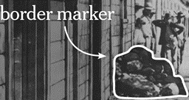
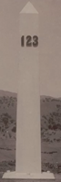
The context of the song “land of the free” (1/3)
End of Mexican-American war: Mexico loses 50% of its territory, now known as California and Texas
Initially, there is no wall, just a pile of stones at regular intervals
1891: piles of stones replaces by white pillars
1897: US demolish buildings in order to spot smuggling of everyday gods (it is a no mans land that is created between the US and Mexico)
Early 1900s: wire fence to control cattle, 1st time physical fence put up, bigger fence later on to stop illegal immigration
1918: big wire fence, aim, diffuse tension

Slide 12
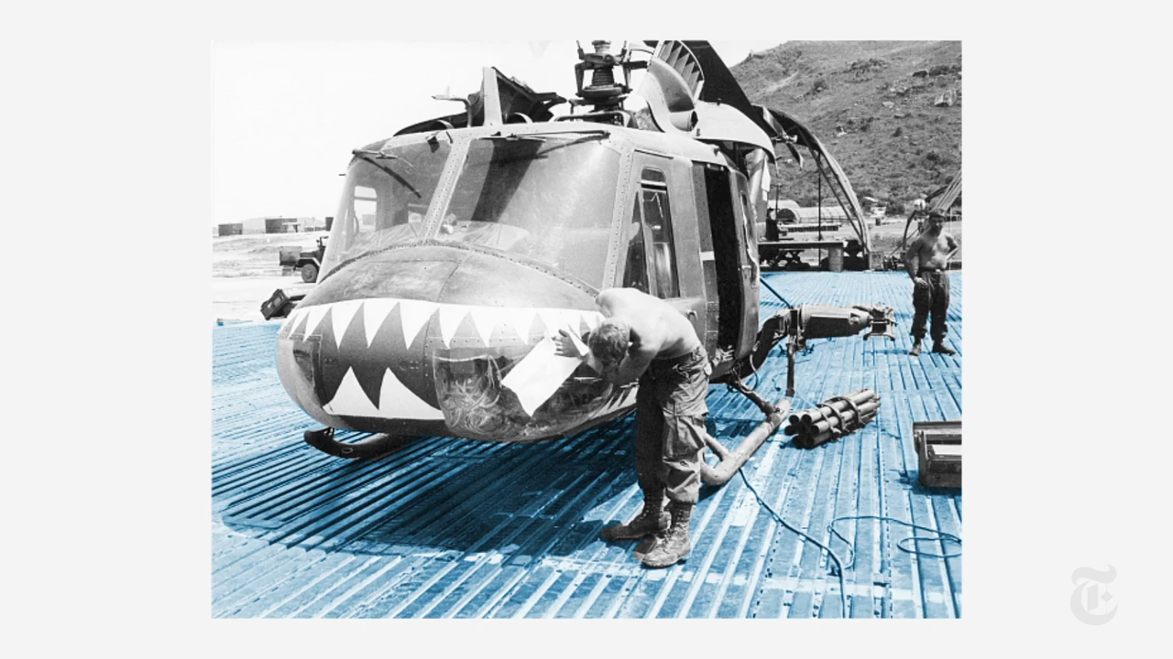
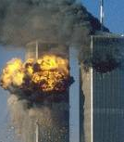
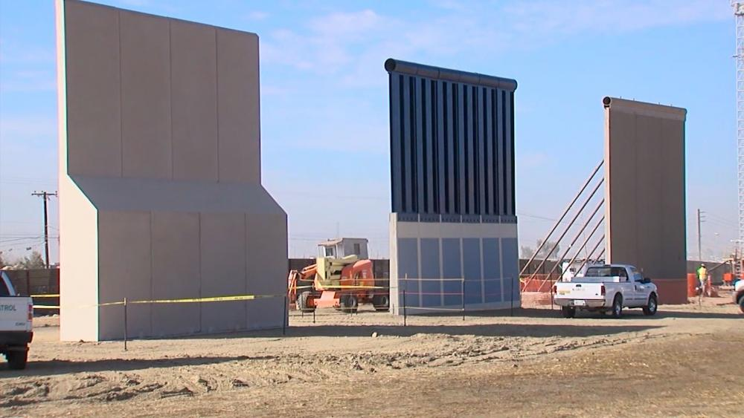
The context of the song “land of the free” (2/3)
1940s: The wall has barbed wire added to it.
1990s: metal fences made of the Vietnamese
helicopter landing mats. (in blue)
September, 11th 2001: Twin towers hit, further tightening of immigration rules, length of walls expanded by five times their Hight
More recent project: replace the Vietnam war mats by concrete walls (Donald Trump).
Through the history of the wall, many different purposes

Slide 13
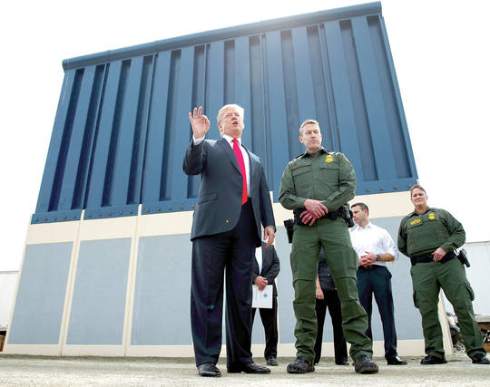
The context of the song “land of the free” (3/3)
Trump project met a lot of opposition
Music
Films
Artwork
“land of the free” illustrates:
The horror
The violence
The immorality of it
“Land of the free”
America is the land of the free
“I’m standing crying”, “Oh oh oh, oh oh oh” and “land of the free”
Every paragraph

Slide 14
Summary
The anti-Mexican poster
The meaning of the poster
An extract of the song “ land of the free”
The context of the song “land of the free”
The context of the song “land of the free” and the see saw
Our personal opinion
Credits

Slide 15
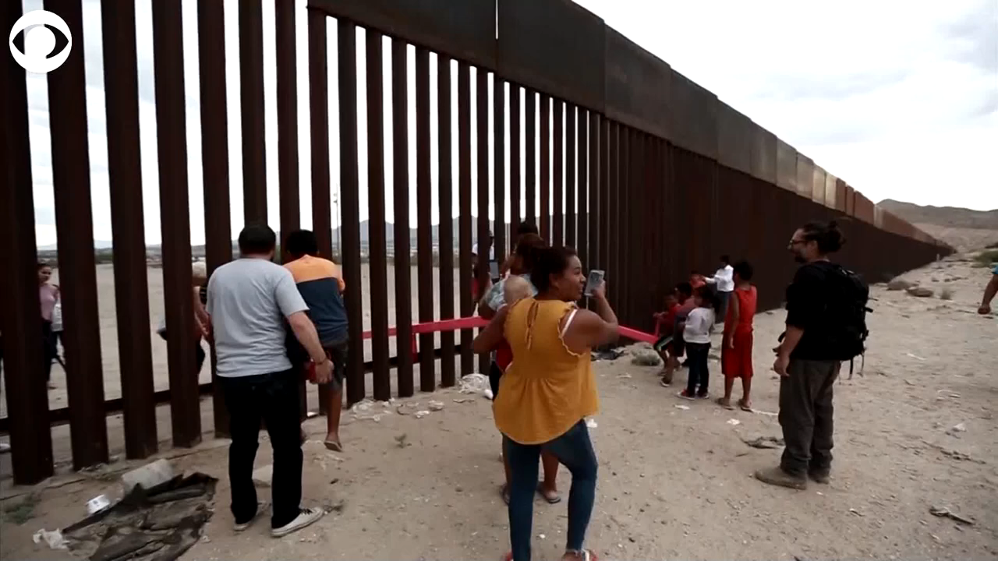
The context of the song “land of the free” and the see saw wall

Slide 16
Summary
The anti-Mexican poster
The meaning of the poster
An extract of the song “ land of the free”
The context of the song “land of the free”
The context of the song “land of the free” and the see saw
Our personal opinion
Credits

Slide 17
Our personal opinion
Jean-Maxime
Henry Letellier
Illegal immigration can be a problem
Unjustified hate
Discriminate populations
In some countries, stigmatized citizens
supposedly fighting "terrorism“
Terrorism caused by misery and disasters
United states, “open nation”, joke
Trump pushed to extreme existing situations
Horrible to separate families
Traumatic to block people
Traumatic to stop access to freedom
Fantastic artwork
Racism should be reduced to a minimum

Slide 18
Summary
The anti-Mexican poster
The meaning of the poster
An extract of the song “ land of the free”
The context of the song “land of the free”
The context of the song “land of the free” and the see saw
Our personal opinion
Credits

Slide 19
Credits
The website: https://bit.ly/2kkaajl
The image: https://media4.s-nbcnews.com/j/newscms/2019_33/2023466/170602-russell-lee-segregation-ac-506p_6e00acc731f13c9216ae0a169e65a54e.fit-2000w.jpg
The official video: https://www.youtube.com/watch?v=OIT0ucf_gys
The cropped version was created with Filmora by Henry Letellier: https://youtu.be/M2iZrVs2E8Y
The google Lyrics : https://bit.ly/2lUetC8
The story of the Mexican wall 1: https://bit.ly/2kcRvpo
The story of the Mexicain Wall 2: https://bit.ly/2kmucd2
The images of the twin towers: https://img.20mn.fr/ndp7POGDSEqAc2due7L1cw/310x190_twin-towers-world-trade-center-11-septembre-2001.jpg
The image of three Donald Trump walls: https://www1.cbn.com/sites/default/files/styles/video_ratio_16_9/public/media/slider/images/borderwallconstruction_hdv.jpg?itok=h_E3gTOI
The image of Donald Trump in front of one of his walls: https://www.hawaiitribune-herald.com/wp-content/uploads/2018/03/web1_AP18086723862996.jpg
The images of the pillar, the stone pile an thehelicopter landing mat were taken directly from the video itself.

Slide 20
Thank you for
You’re attention
Listening
Liking and subscribing

